Slide 1

YAY! - Celebrating Education

Slide 2


Python Course
(Basics)

Slide 3
File Handling in Python

Slide 4
Course Agenda for Today
Generators and Decorators
File Handling

Slide 5
Generators
A generator-function is defined like a normal function, but whenever it needs to generate a value, it does so with the yield keyword rather than return. If the body of a def contains yield, the function automatically becomes a generator function.
Generator functions return a generator object. Generator objects are used either by calling the next method on the generator object or using the generator object in a “for in” loop
Lets see an example in the IDE
A more practical type of stream processing is handling large data files such as log files. Generators provide a space efficient method for such data processing as only parts of the file are handled at one given point in time.

Slide 6
Decorators
Decorators are very powerful and useful tool in Python since it allows programmers to modify the behavior of function or class. Decorators allow us to wrap another function in order to extend the behavior of wrapped function, without permanently modifying it.
This is also called metaprogramming because a part of the program tries to modify another part of the program at compile time.
Lets see an example in the IDE

Slide 7
Introduction To Files In Python
In this module, we will learn how to read and write from text files.

Slide 8
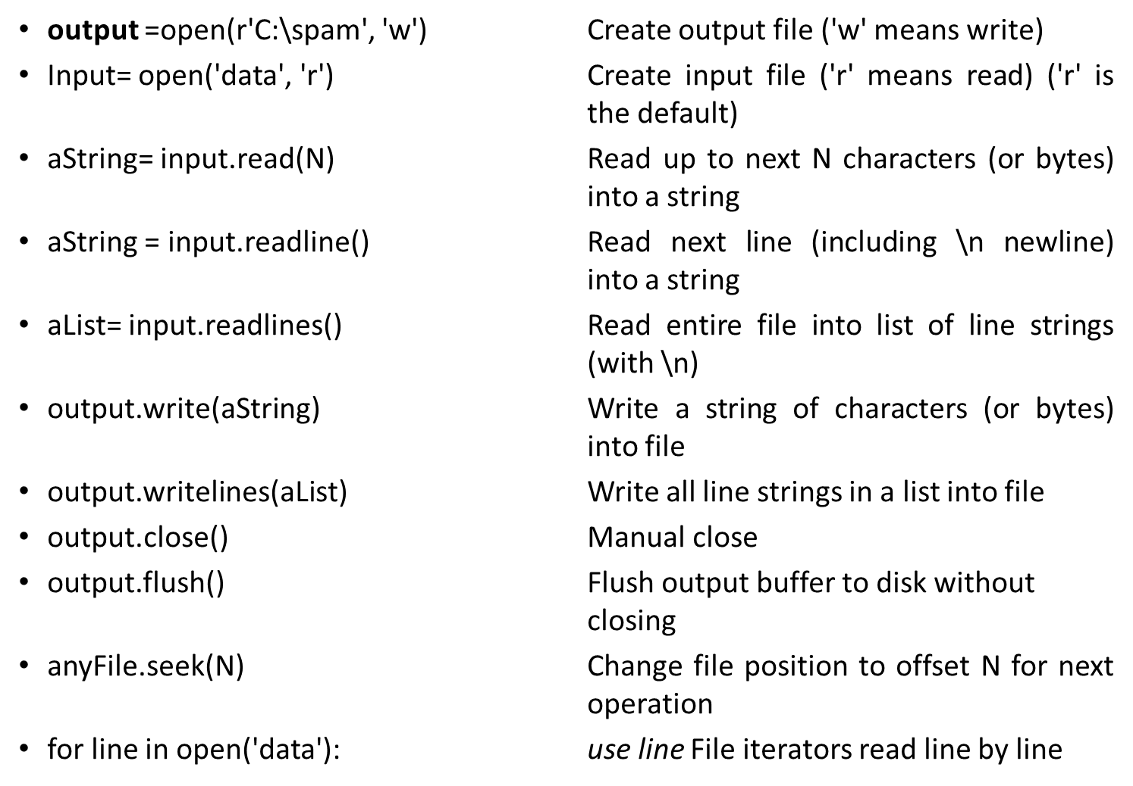
File Operations

Slide 9
Using Files
File iterators are best for reading lines
Content is strings, not objects--that data read from a file always comes back to your script as a string, so you’ll have to convert it to a different type of Python object if a string is not what you need.
close is usually optional--don’t always need to manually close your files,.
Files are buffered and seekable--By default, output files are always buffered, which means that text you write may not be transferred from memory to disk immediately—closing a file, or running its flush method, forces the buffered data to disk.

Slide 10
Opening Files
Prepares the file for reading:
Links the file variable with the physical file (references to the file variable are references to the physical file).
Positions the file pointer at the start of the file.
Format:
<file variable> = open(<file name>, "r")
Example:
(Constant file name)
inputFile = open("data.txt", "r")
OR
(Variable file name: entered by user at runtime)
filename = input("Enter name of input file: ")
inputFile = open(filename, "r")

Slide 11
Opening Files
Working of open() function
We use open () function in Python to open a file in read or write mode. As explained above, open ( ) will return a file object. To return a file object we use open() function along with two arguments, that accepts file name and the mode, whether to read or write. So, the syntax being: open(filename, mode). There are three kinds of mode, that Python provides and how files can be opened:
“ r “, for reading.
“ w “, for writing.
“ a “, for appending.
“ r+ “, for both reading and writing
Lets see an example in the IDE

Slide 12
Reading information from files
Prepares the file for reading:
Links the file variable with the physical file (references to the file variable are references to the physical file).
Positions the file pointer at the start of the file.
Format:1
<file variable> = open(<file name>, "r")
Example:
(Constant file name)
inputFile = open("data.txt", "r")
OR
(Variable file name: entered by user at runtime)
filename = input("Enter name of input file: ")
inputFile = open(filename, "r")

Slide 13
Working of read() mode
There is more than one way to read a file in Python. If you need to extract a string that contains all characters in the file then we can use file.read(). The full code would work like this:
Another way to read a file is to call a certain number of characters like in the following code the interpreter will read the first five characters of stored data and return it as a string
Lets see an example in the IDE

Slide 14
Writing to a File
You can use the ‘write()’ function in conjunction with a file variable.
Note however that this function will ONLY take a string parameter (everything else must be converted to this type first).
Format:
outputFile.write(temp)
Example:
# Assume that temp contains a string of characters.
outputFile.write (temp)
Lets see an example in the IDE

Slide 15
Closing The File
Although a file is automatically closed when your program ends it is still a good style to explicitly close your file as soon as the program is done with it.
What if the program encounters a runtime error and crashes before it reaches the end? The input file may remain ‘locked’ an inaccessible state because it’s still open.
Format:
<name of file variable>.close()
Example:
inputFile.close()

Slide 16
Thank You!
See you in the next class!

